Slide 1
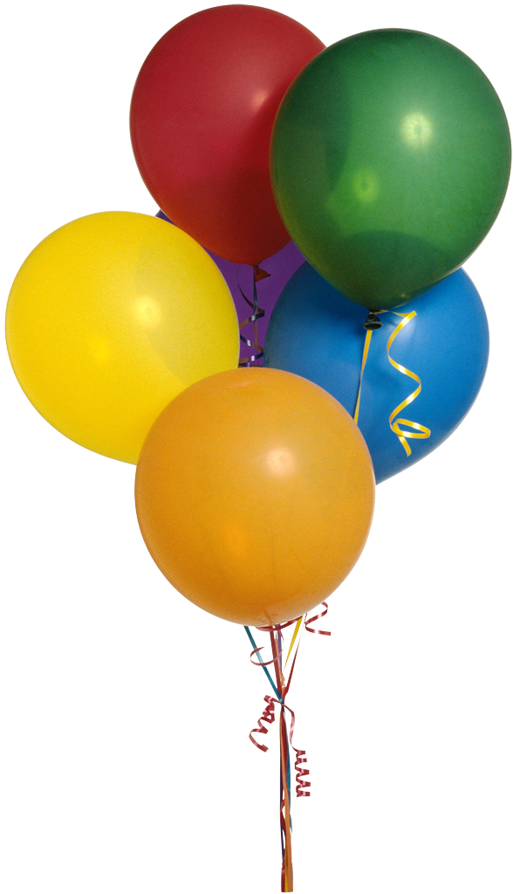
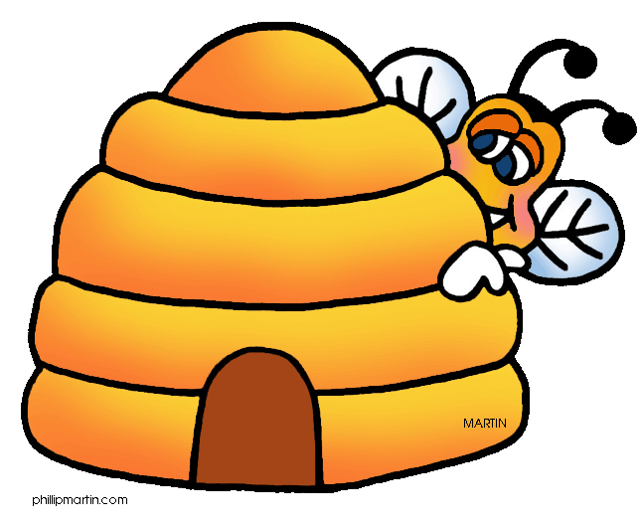



Sarah the Craft Blogger’s
Rosh Hashanah Contest
שנה טובה

Slide 2
Contest Rules
Write a short essay (100-150 words) explaining your New Year’s resolution(s)and how you plan to institute them in the coming year.
Submit the essay with your first and last name and your age. All ages are welcome!
All entries must be submitted to:
craftbloggerscontest@gmail.com

Slide 3
When is the Contest?
The contest begins on September 10th at 12:00am Pacific time (PT), 3:00am Eastern time (ET).
The contest ends on October 2nd at 12:00am Pacific time (PT), 3:00am Eastern time (ET).

Slide 4
Contest Rewards
A minimum of 10 winners will be selected and mailed a surprise reward!
If you are selected as a winner, you will be contacted via email so that your mailing address may be obtained so that your prize can be sent to you.
If the contestants authorize/grant permission, the essays will be published on Yaldah.com for all to enjoy and learn from.

Slide 5

I’m looking forward to reading your entries!
-Sarah the Craft Blogger
P.S. If you have any questions or concerns, send them to:
craftbloggerscontest@gmail.com

